Slide 1
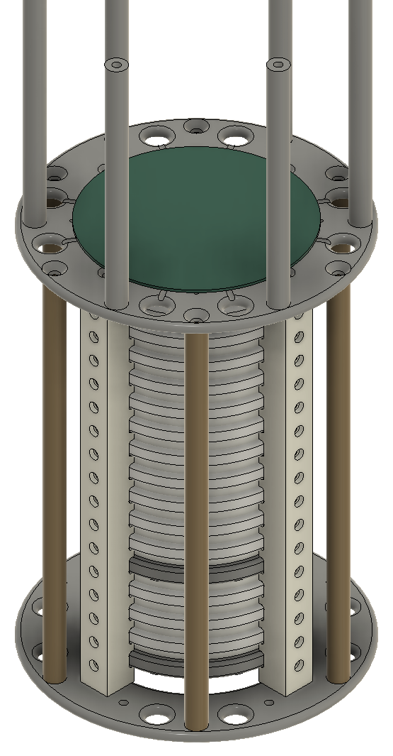
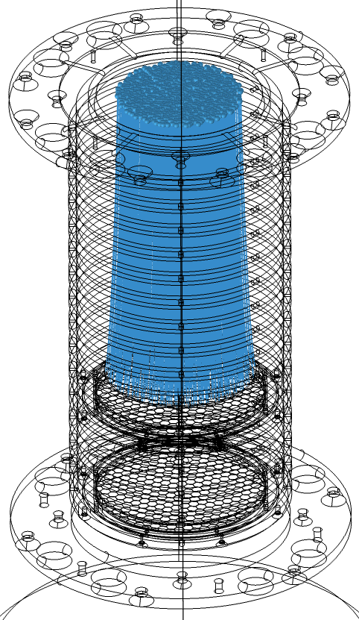
Additional Analysis and Documentation of the UTAH-TPC
and
Variants

Slide 2
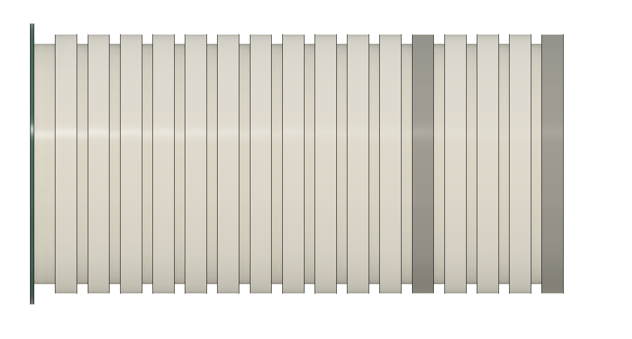
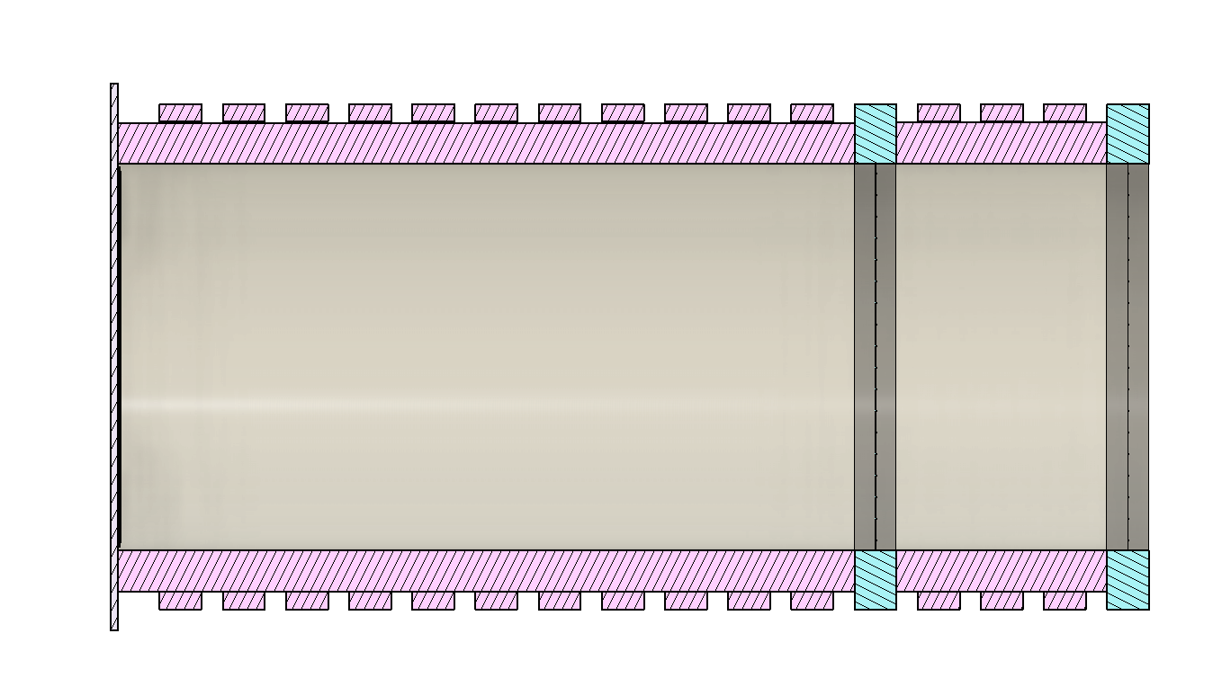
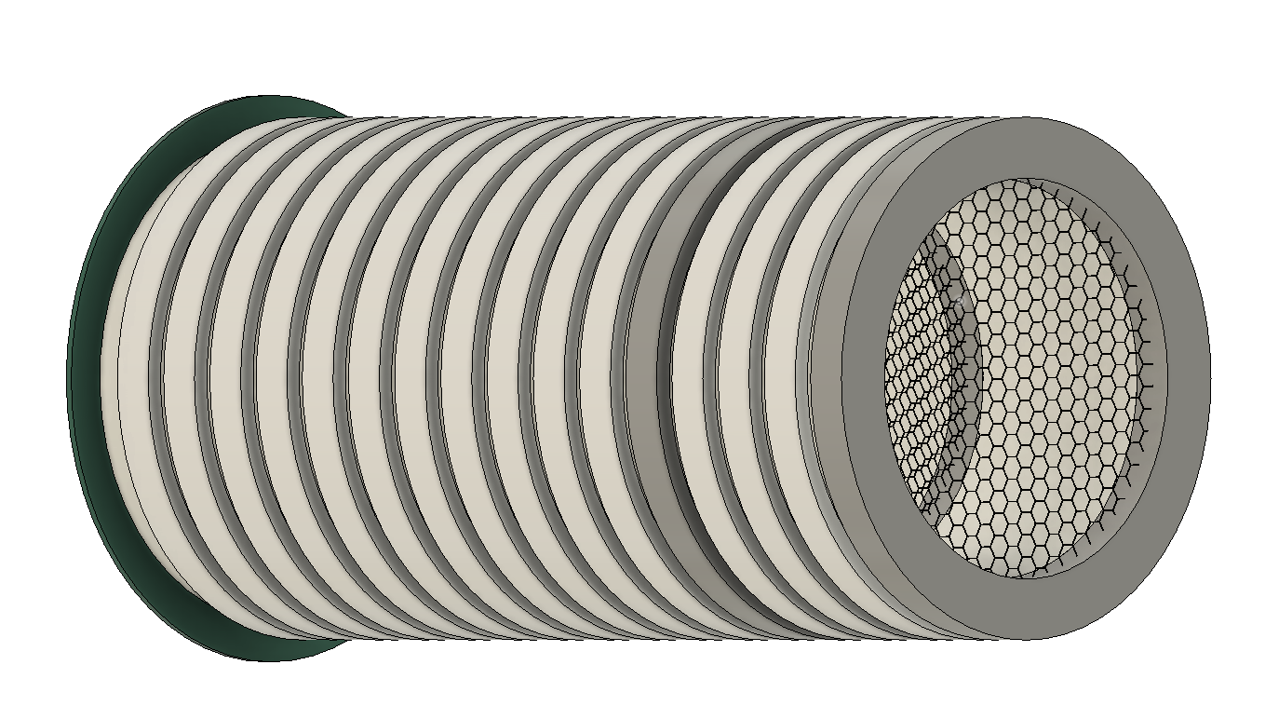
Side View
Cross Section Cut
Side Tilt View
A
B
C
D
E
F
A – Collection Plane B – Electron Field Rings C – Electron Drift Region D – High Density Polyethylene
E – Hexagon Mesh Grid Field Rings F – Buffer Region

Slide 3
TPC Regions of Interest for Simulation
Charge Drift Region
Buffer Region

Slide 4
TPC Field Configurations
Positive Voltage Bias
Negative Voltage Bias
V = 0
HV +
V = 0
V = 0
HV -
V = 0
Legend
Force on Positive Charges
Force on Negative Charges
Enlarged Arrows to express area of effect

Slide 5
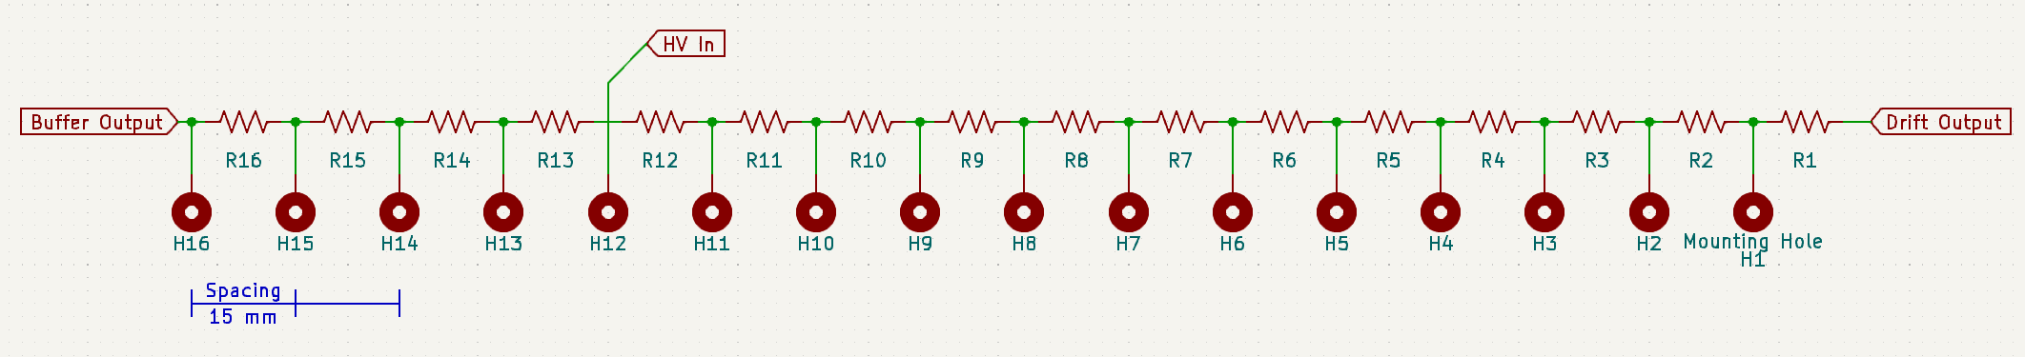
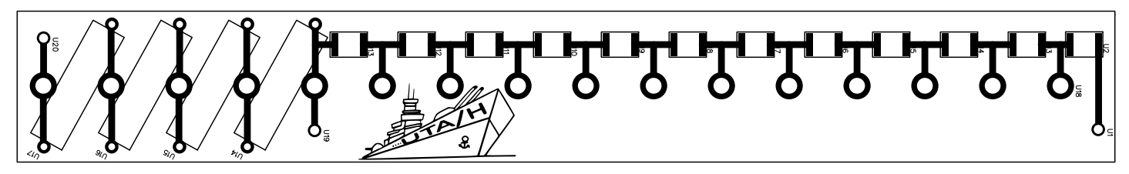
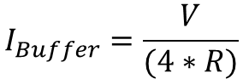
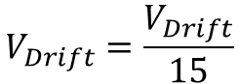
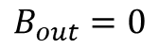
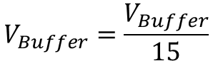
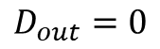
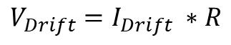
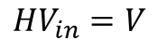
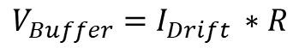
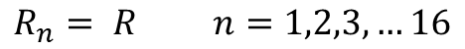
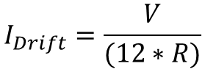
Cage Potential Circuit Diagram
2D Render of PCB Board
From Original Documentation
Static Field Cage Calculations
Boundaries
Currents
Voltage Drop per Resistor
Voltage Drop / mm
$R_{n}= R$ $n=1,2,3,…16$
$$I_{Buffer}=\frac{V}{(4∗R)}$$
$V_{Buffer}=I_{Drift} ∗R$
$$V_{Buffer}=\frac{V_{Buffer}}{15}$$
$${HV}_{in}=V$$
$$D_{out}=0$$
$$I_{Drift}=\frac{V}{(12∗R)}$$
$$V_{Drift}=\frac{V_{Drift}}{15}$$
$V_{Drift}=I_{Drift} ∗R$
$$B_{out}=0$$

Slide 6
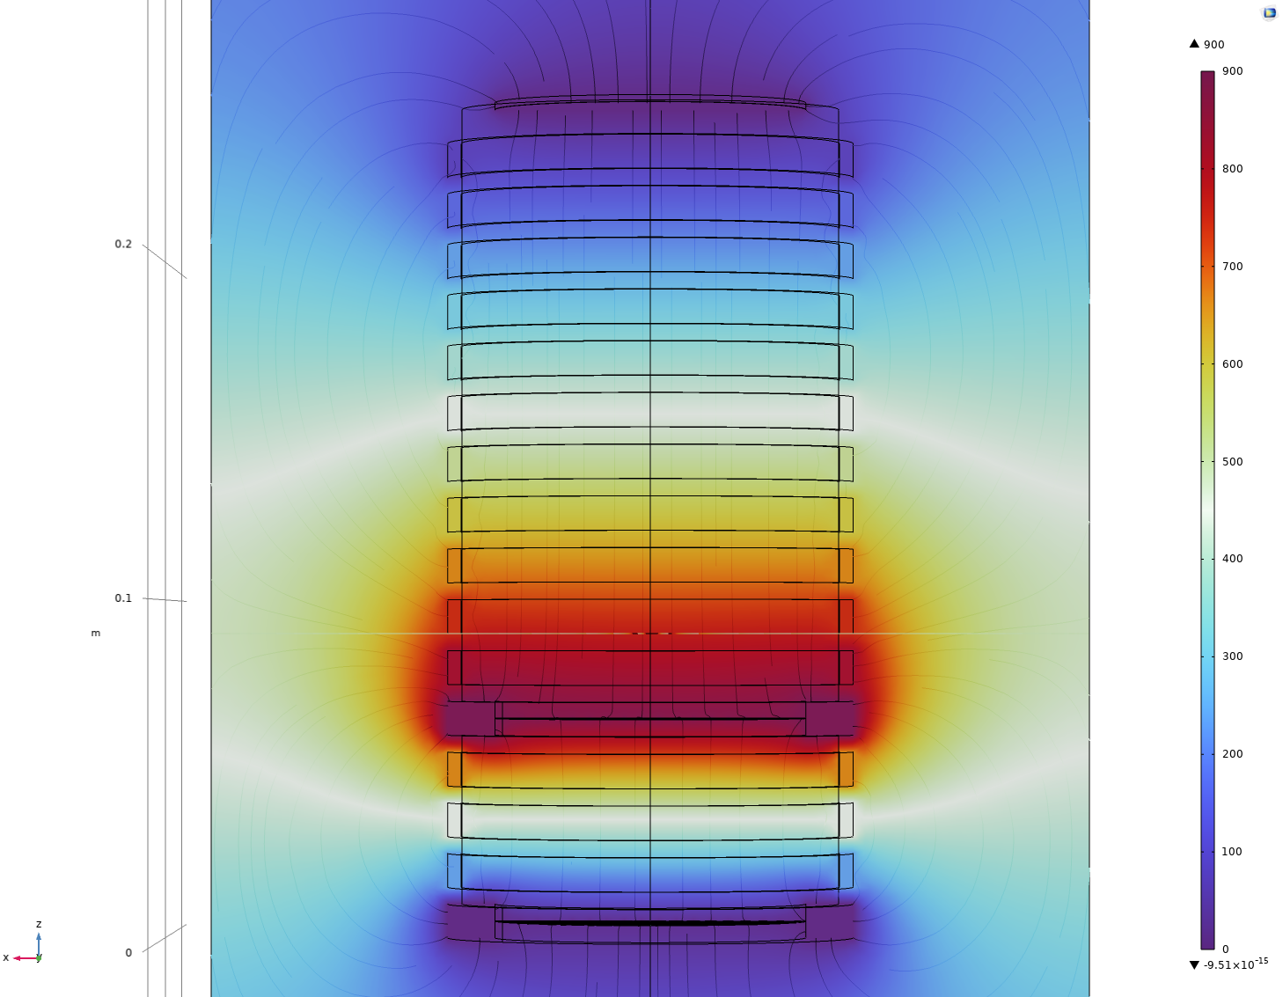
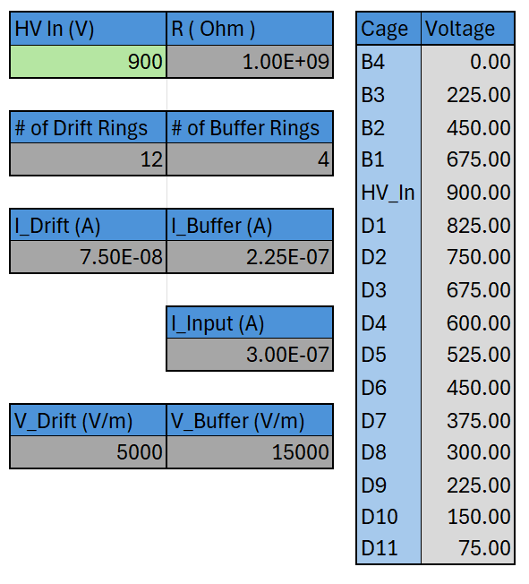
Excel Sheet Calculator
COMSOL Simulation
Expected Drift Directions from Simulation Results
B4
Voltage In
Resistor Value
B3
B2
Number of Static Rings per Area
B1
Field Section Currents
HV
D1
System Current
D2
Field Voltage Drop
D3
D4
Ring Bias
D5
Changing the green box in the excel sheet will update all values. All other values are constant or set.
D6
D7
D8
D9
D10
D11
Enlarged Arrows to express area of effect

Slide 7
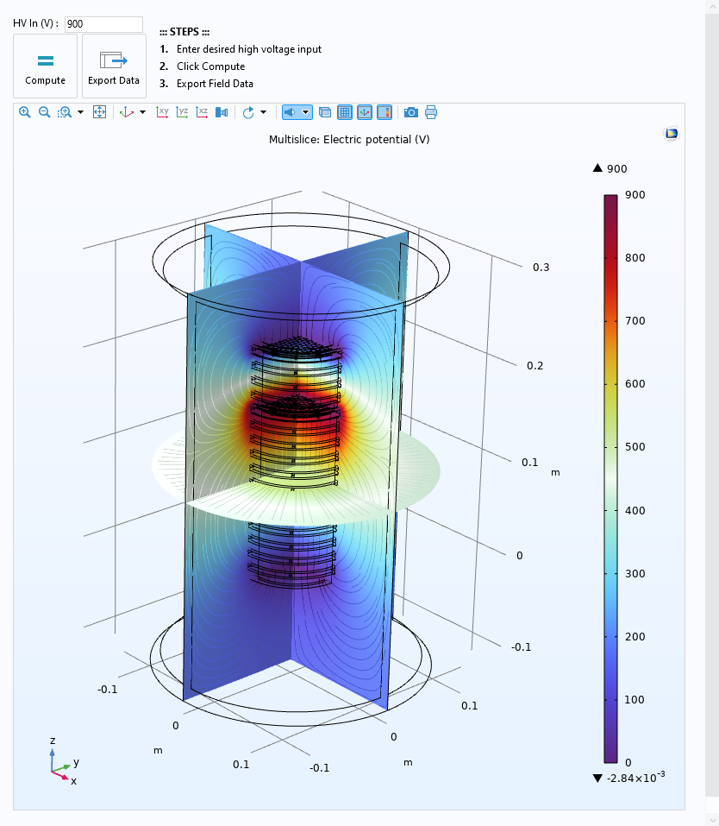
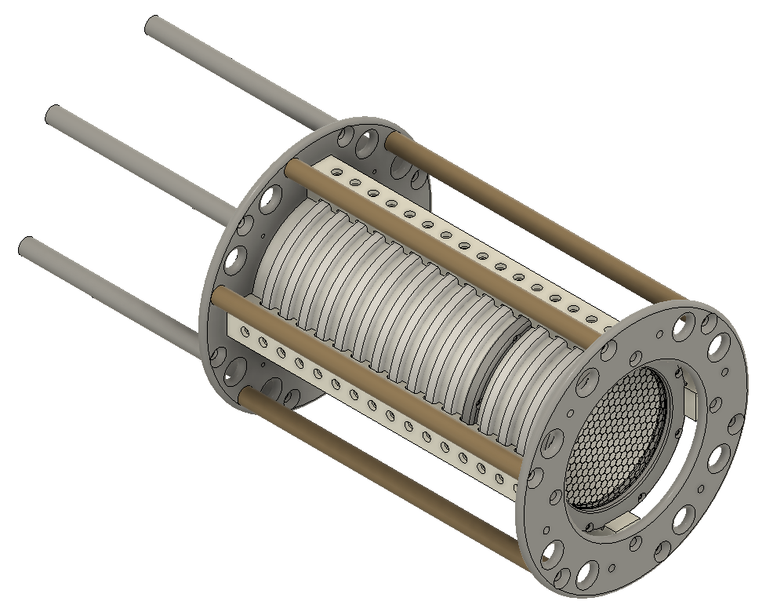
COMSOL Application for Field Cage Analysis of Real Model
The solutions to the UTAH TPC Electric Field have been set up in COMSOL. High Voltage can be adjusted for desired input voltage, then it can be solved using the [COMPUTE] button Field Values can be exported as a .txt document using the [EXPORT DATA] button ElectricField.UTAHTPC.mph can be used for initial analysis for field values. Model contains only the “central” system and none of the mechanical supports.

Slide 8
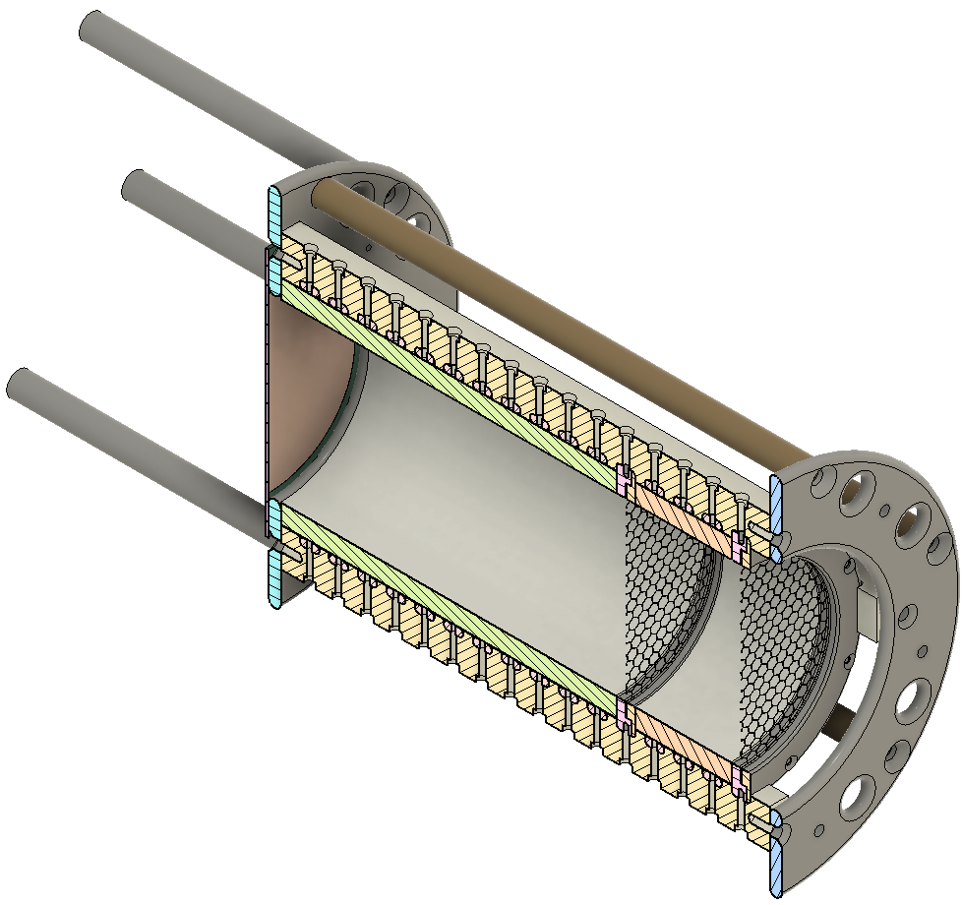
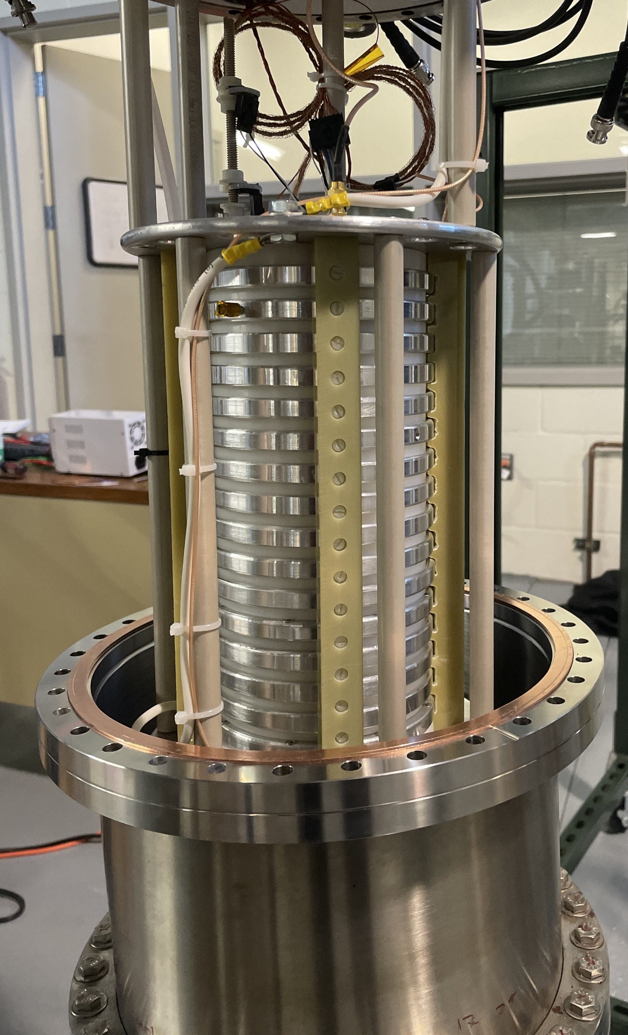
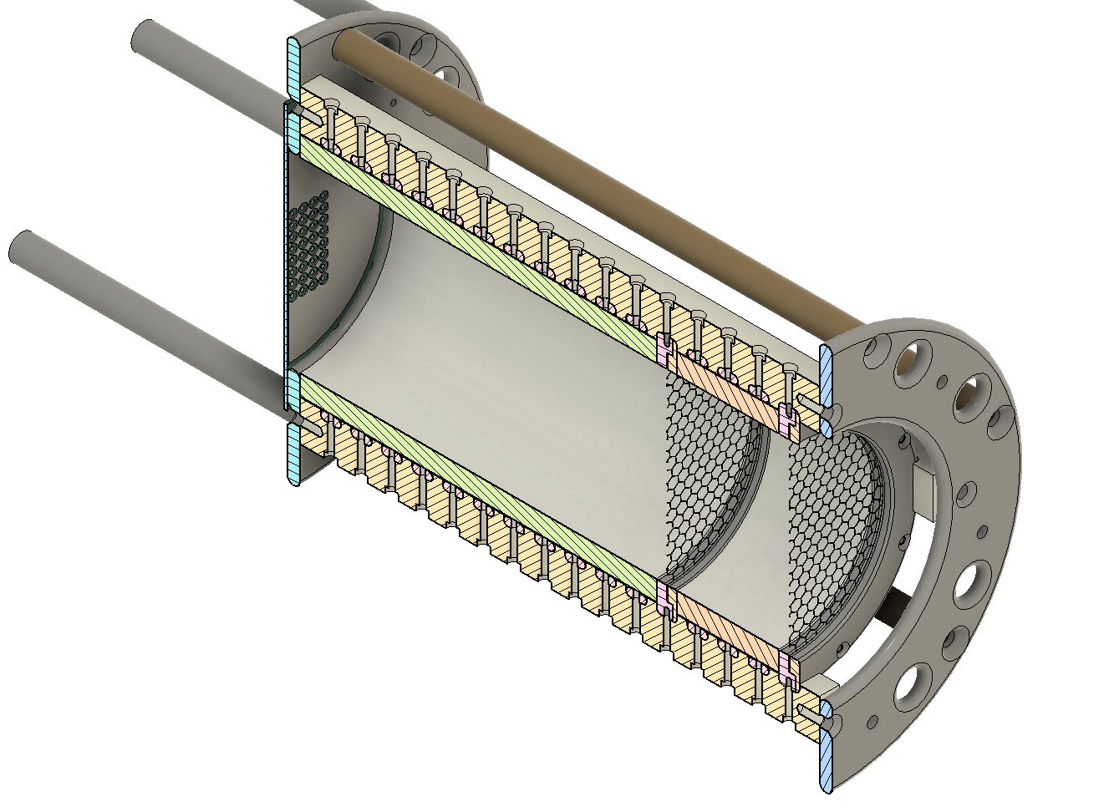
Reality
UTAH-TPC Model
UTAH-TPC Pixel Simulation Model
Current
Future

Slide 9
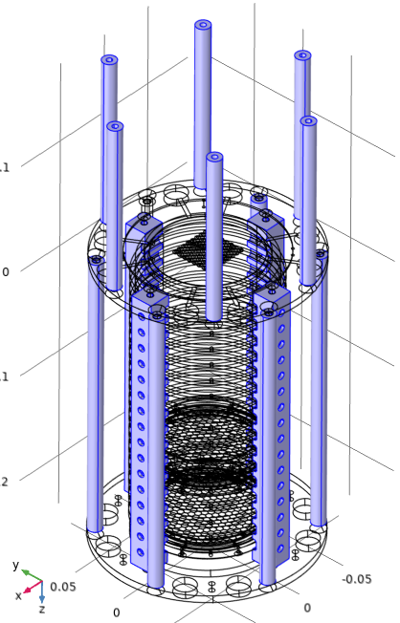
Neglected Geometries for Computation on Existing Models
PEEK Support rods and G10 legs are included in the COMSOL model, but for this computation they have been removed. These components provide are placed for structural support; material is a dielectric for We are interested in the area inside, therefore, to reduce computation times for initial results they have been removed. They remain in the file but are removed using the [Delete Entities ‘del 1’ ] function named “Negligible Geometries.” These components can be added if desired in the computation, but a custom finer mesh must be defined to create no overlap between curved surfaces.

Slide 10
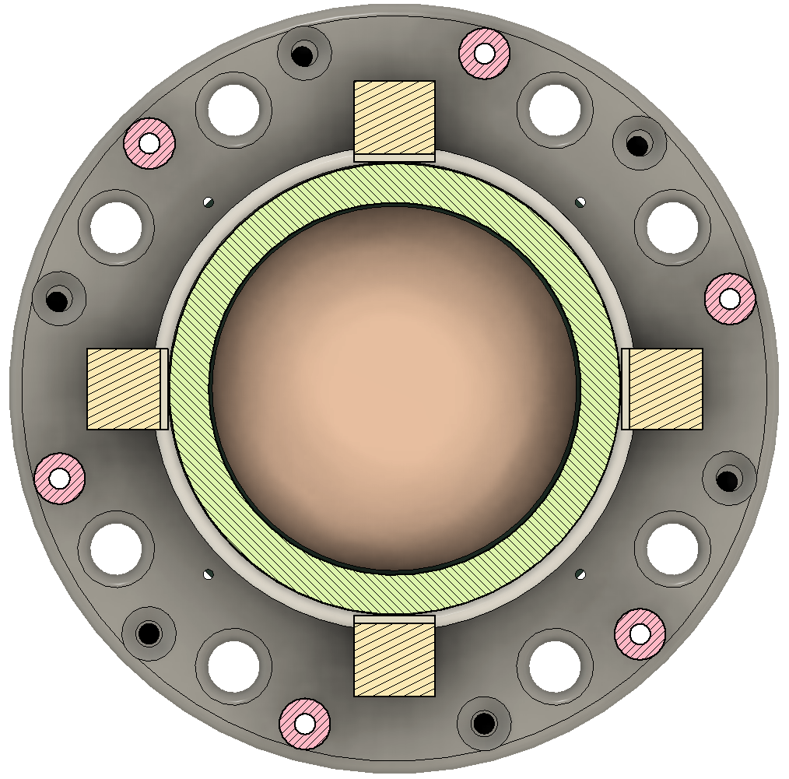
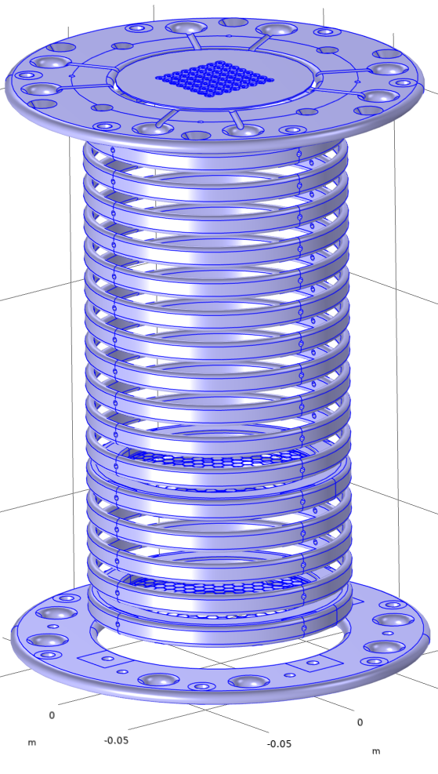
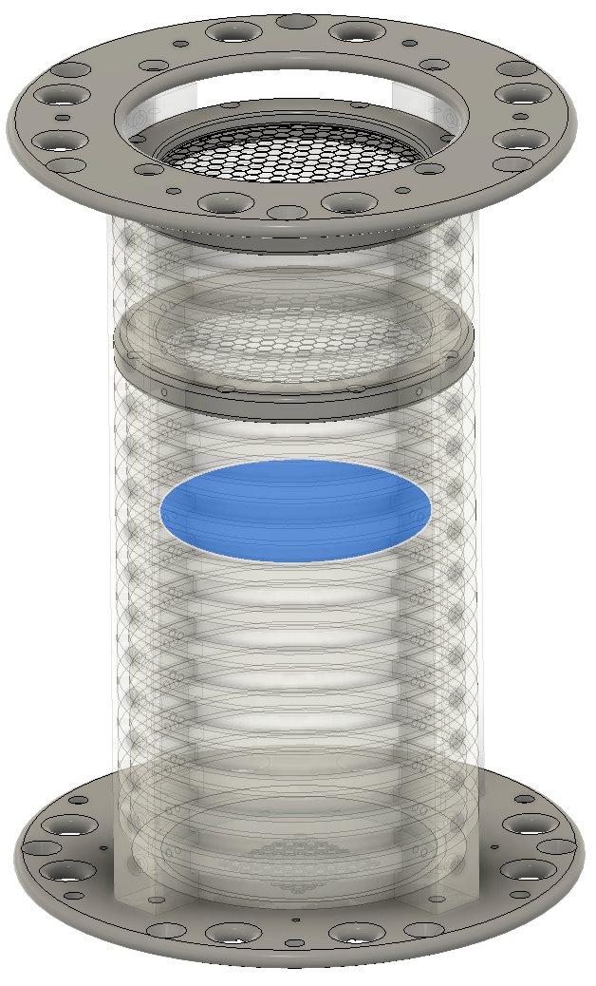
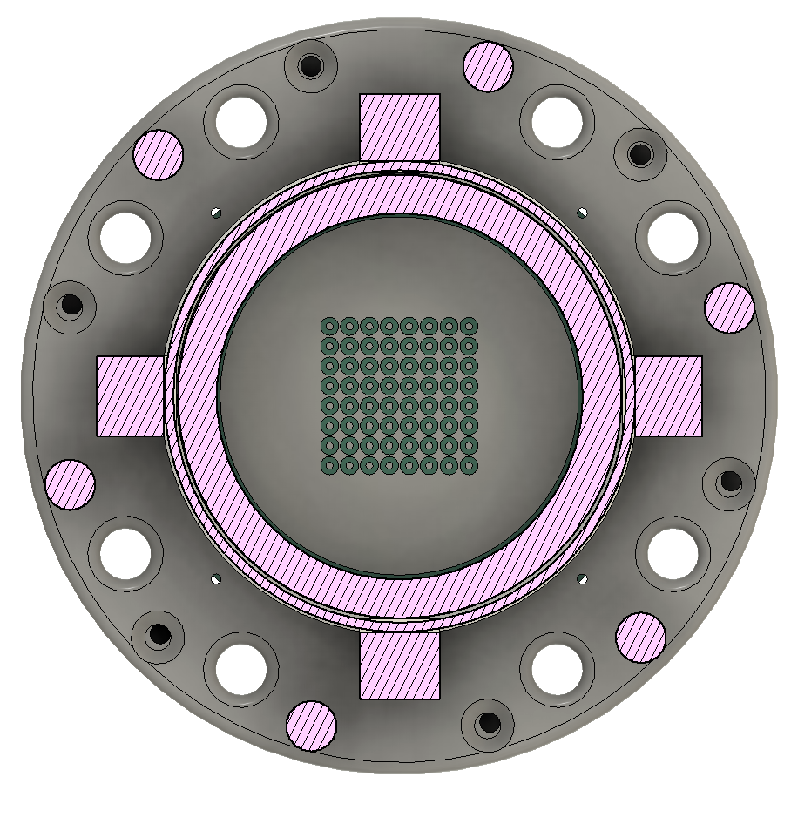
Parameters Determinable in UTAH-TPC Application
Collection Methods
Rings and Frame Biases
Electron Release
Includes Enclosure (Not Displayed)
1
2

Slide 11
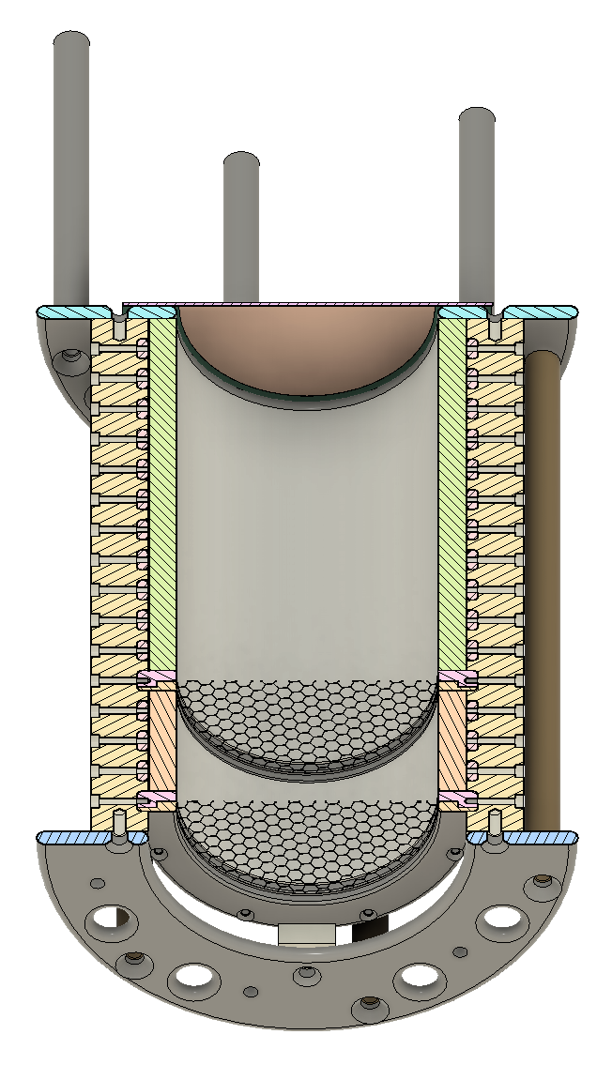
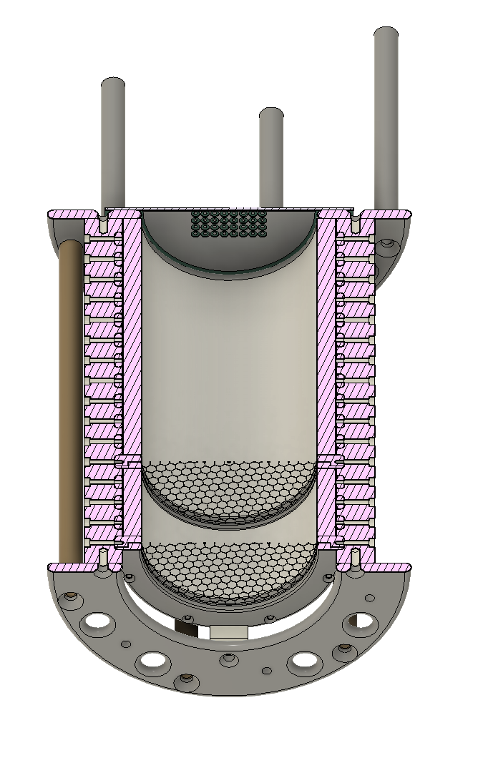
Current UTAH-TPC Model
Future UTAH-TPC Pixel Model
More Information of the System available in the original documentation

Slide 12
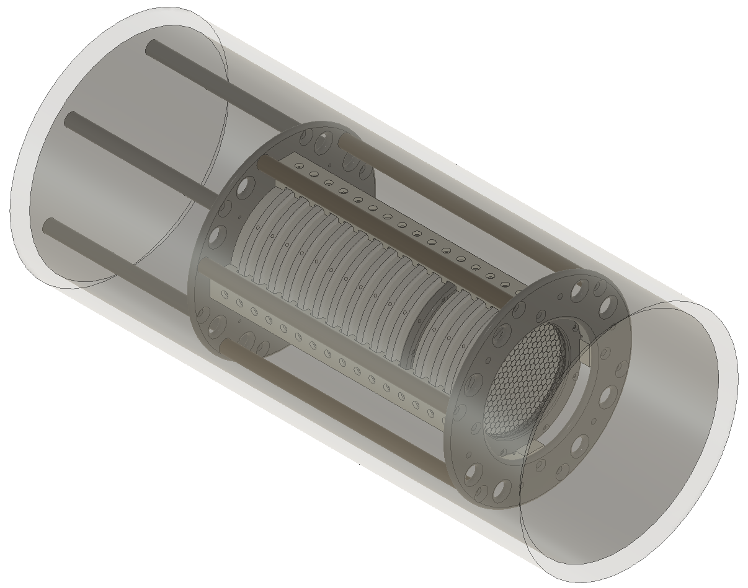
Current UTAH-TPC Simulation Model
Collection Plane
Models Available
Enclosed TPC: [Enclosed.TPC.Single.Channel.step]
1

Slide 13
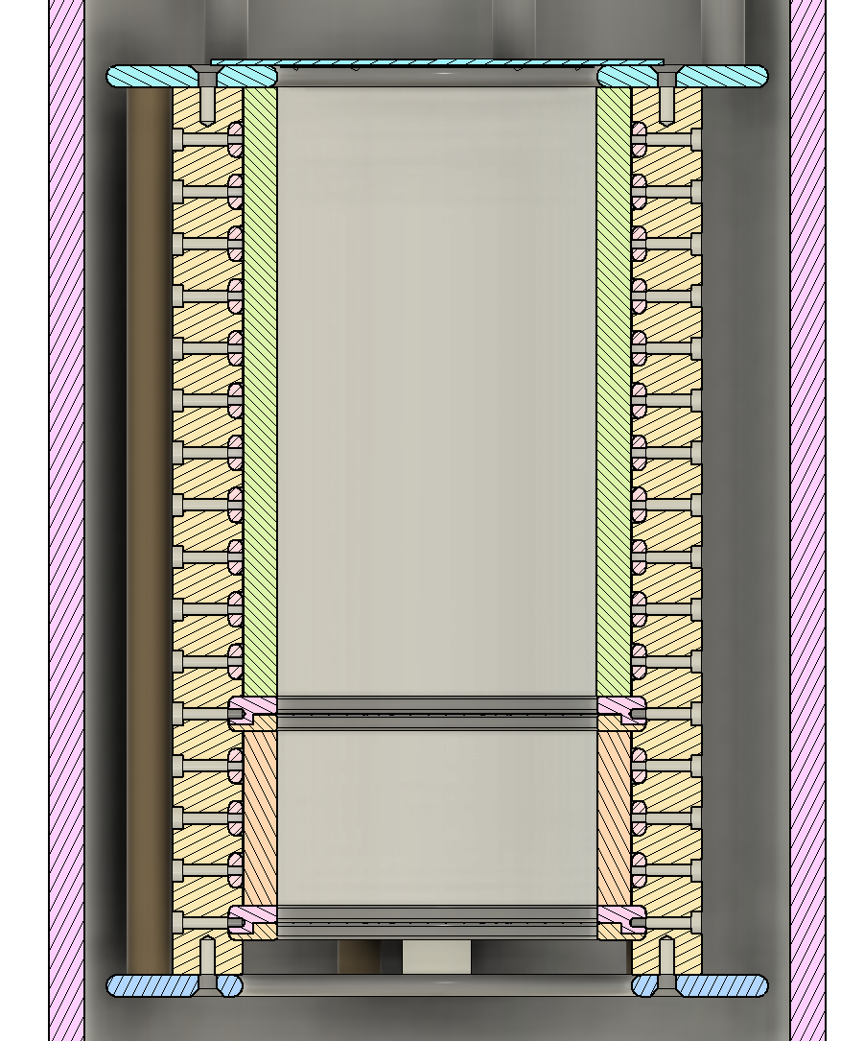
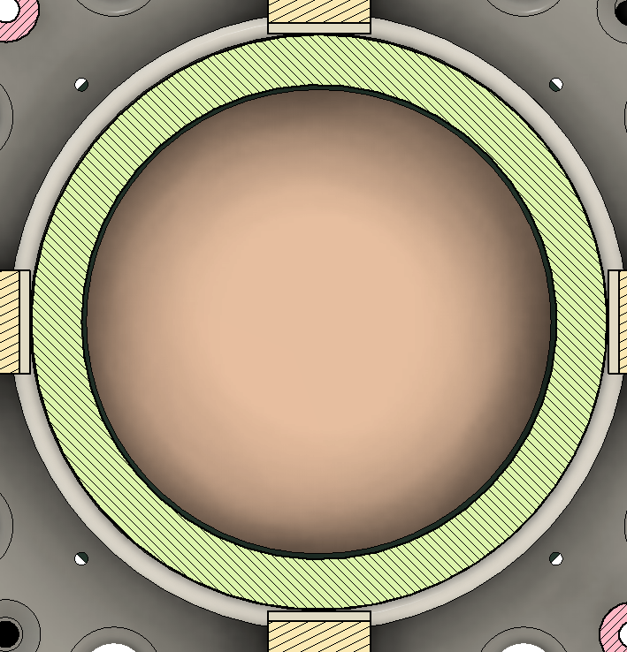
Electric Field Boundaries
Collection Plane
Frame
D11
D10
D9
D8
Collection Anode
D7
D6
D5
D4
D3
D2
D1
HV
B1
B2
B3
B4
Frame
1

Slide 14
Future UTAH-TPC Simulation Model
Pixel Plane and Mesh
Models Available
Exposed TPC : [ Exposed.TPC.step ]
Enclosed TPC : [ Enclosed.TPC.step ]
Concept of a pixel design with a biased mesh. Higher density of pixels increase resolution. Biased Mesh is used to focus charged particles onto pixels.
2

Slide 15
Electric Field Boundaries
Pixel / Mesh
Frame
D11
D10
D9
D8
Mesh
D7
D6
Pixel
D5
D4
D3
D2
D1
HV
B1
B2
B3
B4
Frame
2

Slide 16
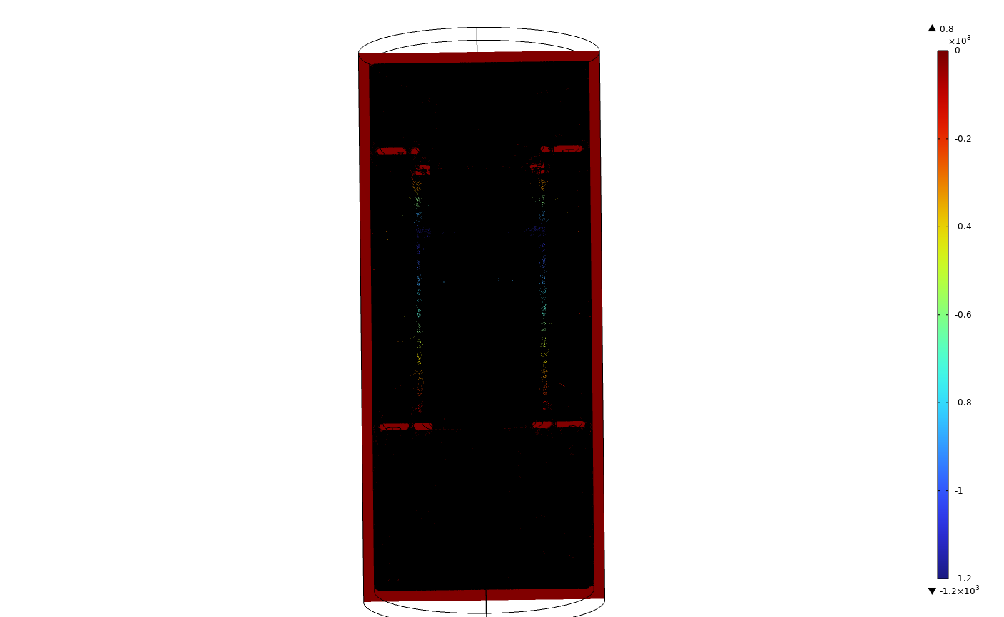
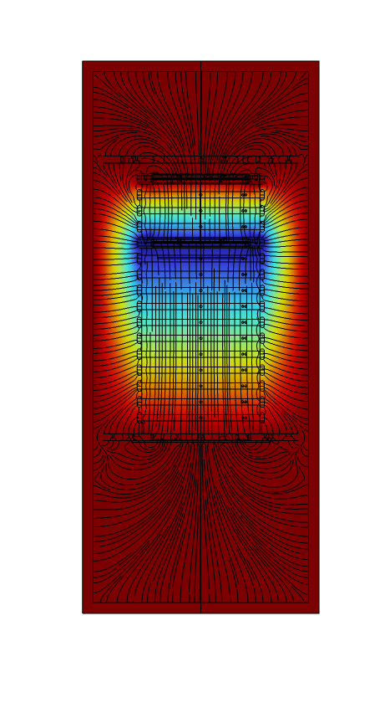
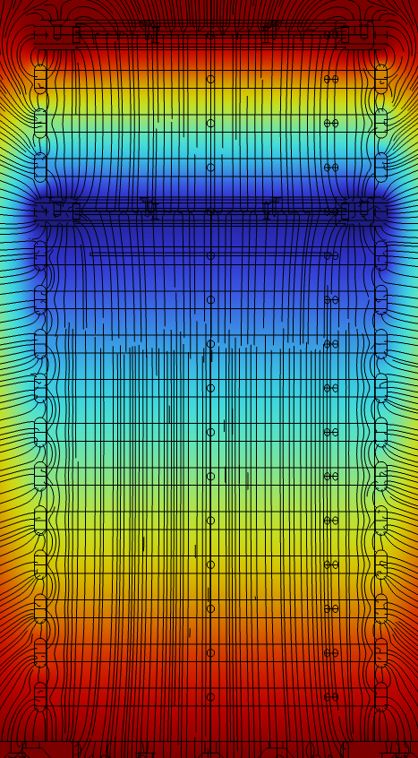
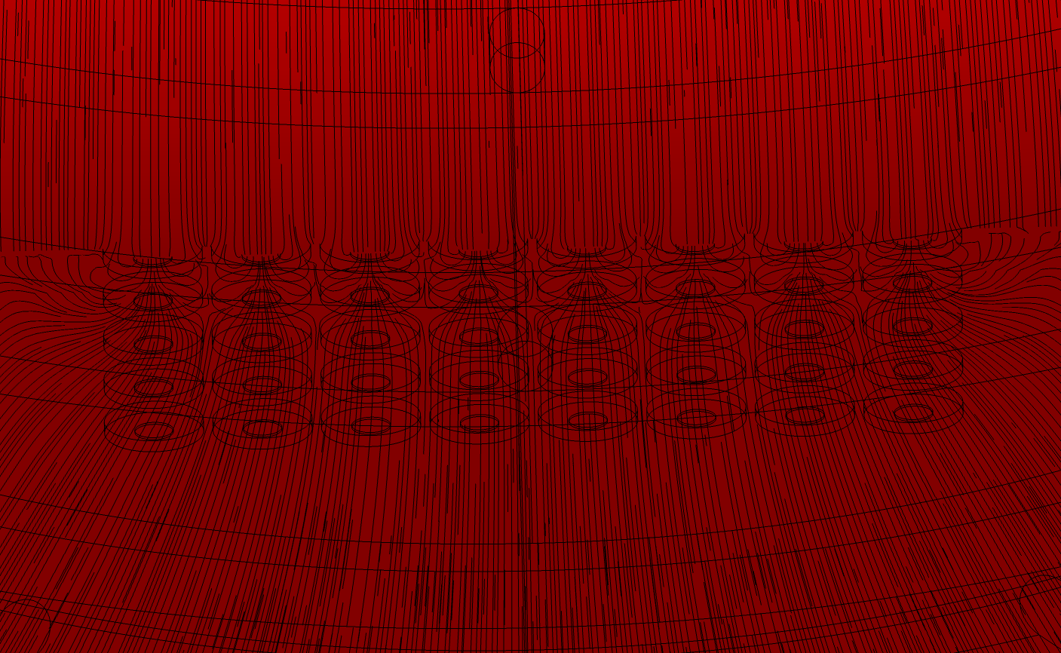
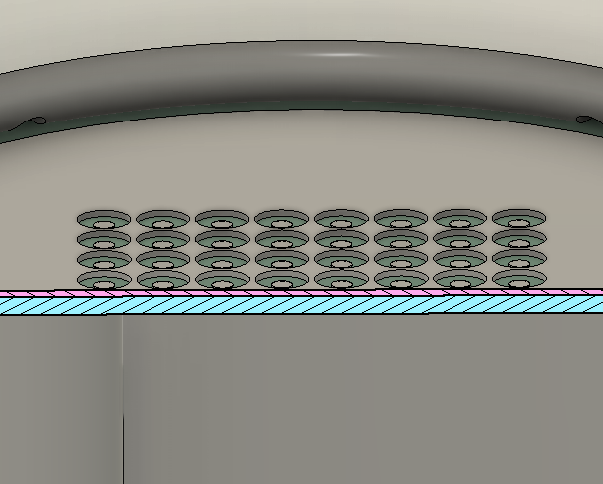
Voltage (V)
System
Field Cage
Pixel Termination
2

